Slide 1
Predicting fetal states based on Cardiotocography (CTG)
Ke Wang
Master’s Student in Translational Biotechnology
USC Keck School of Medicine
Email: kwang558@usc.edu
Github: kechristywang

Slide 2
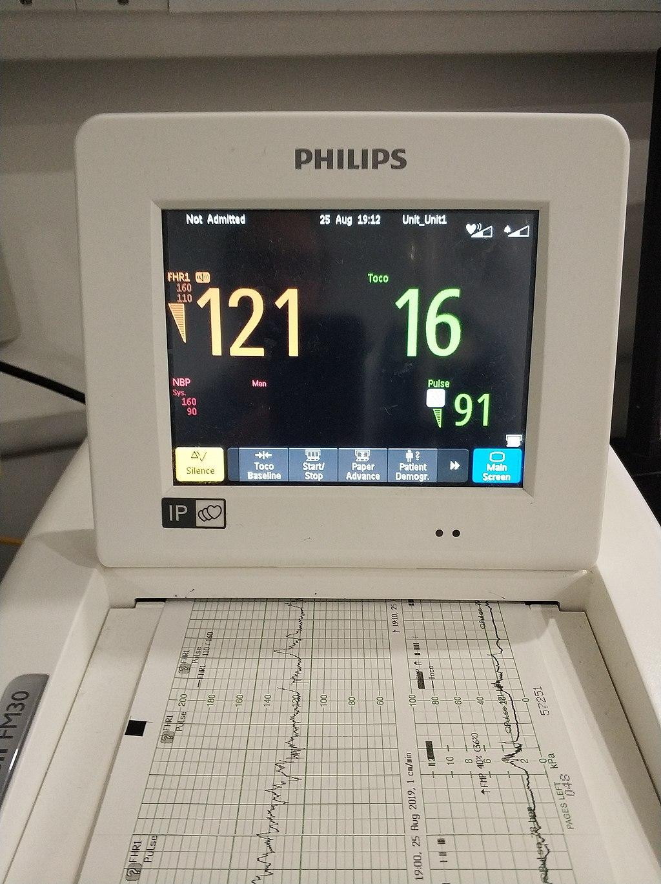
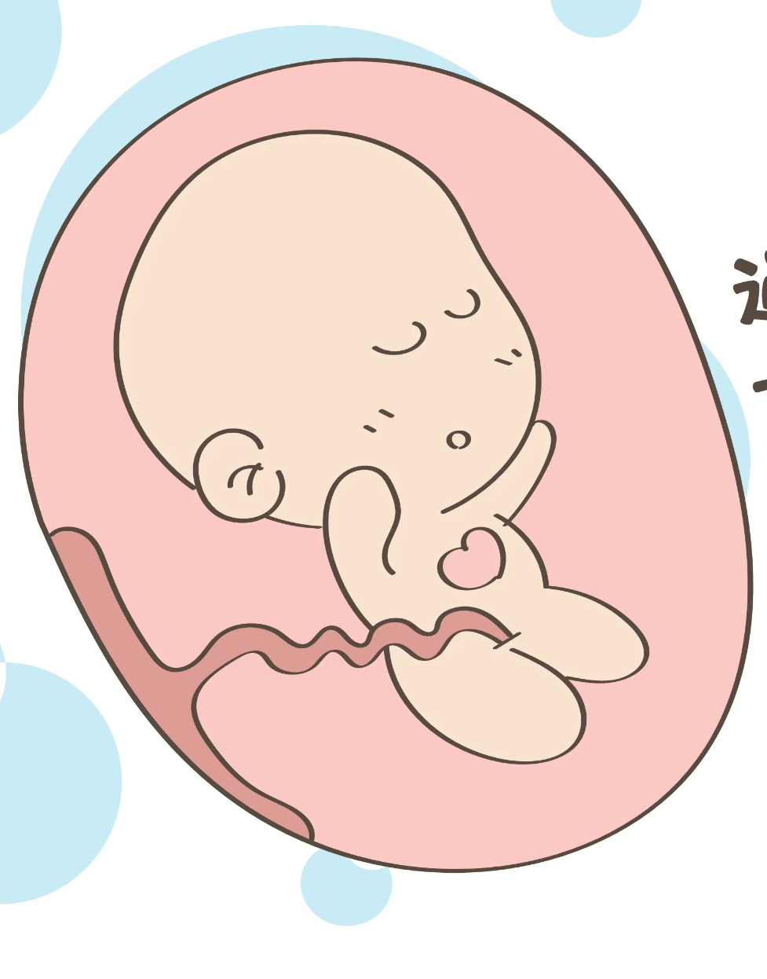
Cardiotocography (CTG)

Slide 3
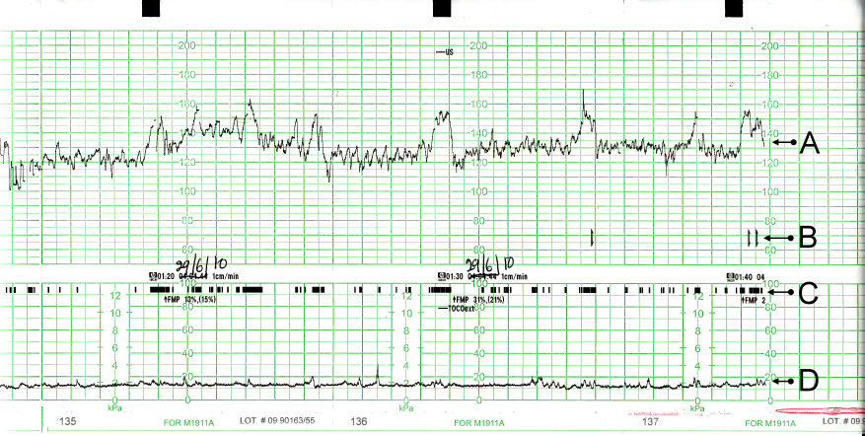
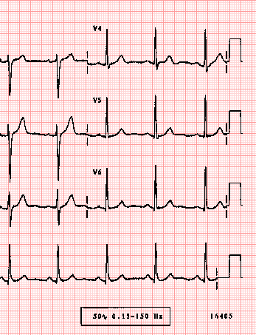
CTG Histogram
Fetus
Adult

Slide 4
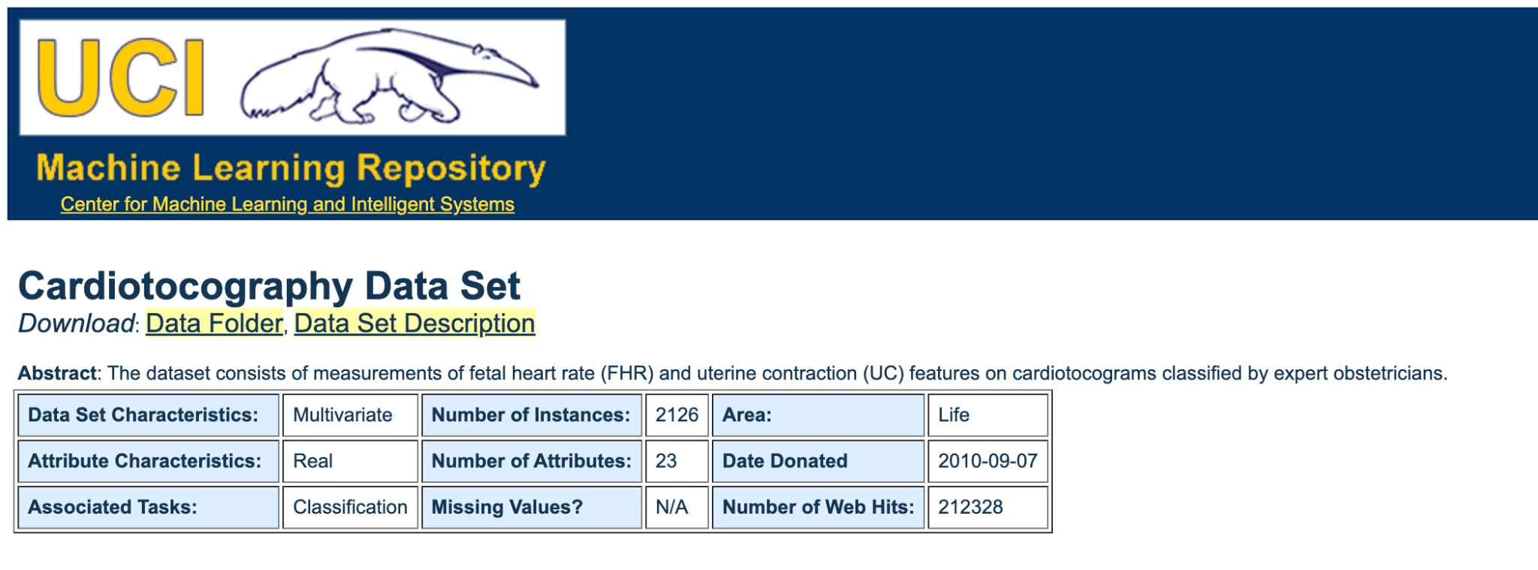
CTG Dataset Source
Normal: | 1655
Suspect: | 295
Pathologic: | 176
Source: https://archive.ics.uci.edu/ml/datasets/Cardiotocography#

Slide 5
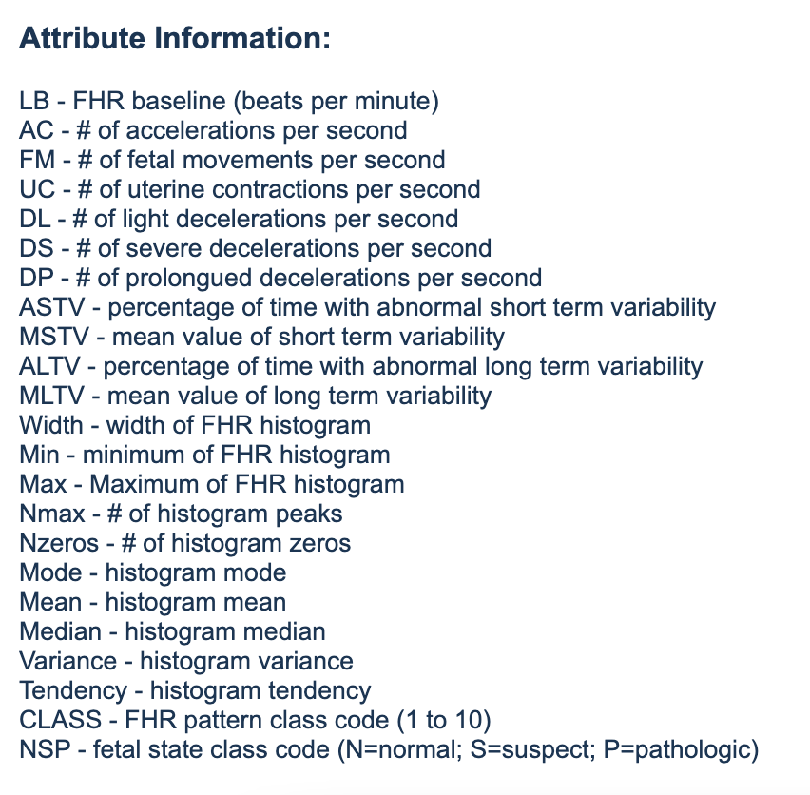
Important Features in CTG Dataset
DP
AC
DS
DL
FM
UC

Slide 6
Important Features in CTG Dataset
Max
peak
Min
Tendency

Slide 7
Attribute Information
categorical
Number of Features: 23
Exam Data
Measurements
Classification
File Name
23 CTG Features
10 Morphologic Pattern
Date
22 Numerical Features
1 Categorical Feature
CLASS
Segfile
NSP (Target)
b
e
Ayres de Campos et al. (2000) SisPorto 2.0 A Program for Automated Analysis of Cardiotocograms. J Matern Fetal Med 5:311-318

Slide 8
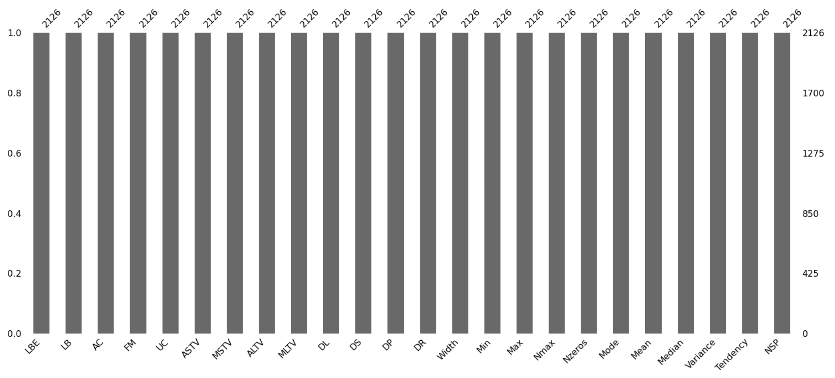
Dataset Integrity
Number of Features: 23

Slide 9
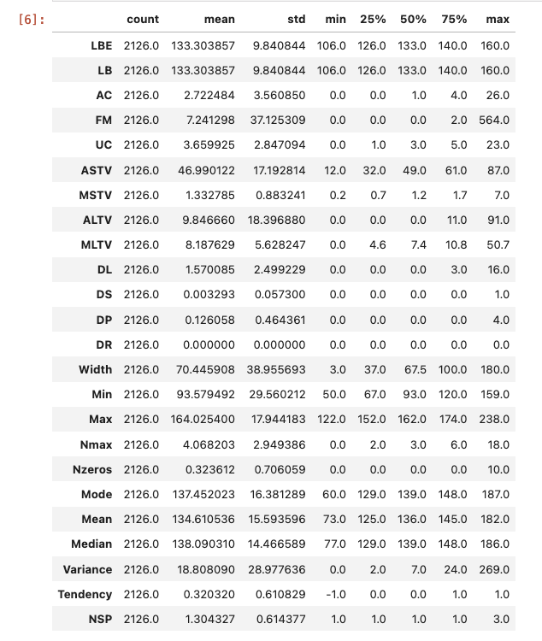
Data Characteristics
Number of Features: 21

Slide 10
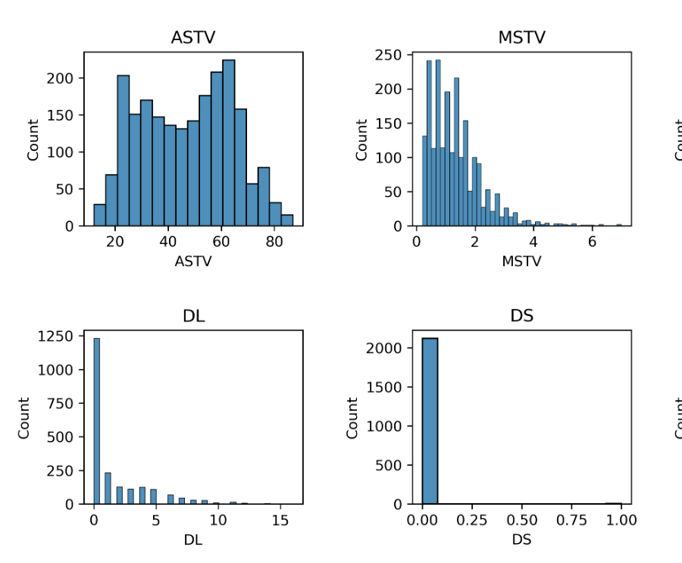
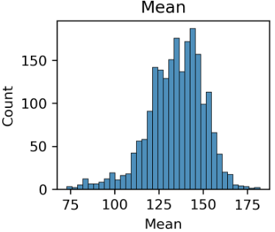
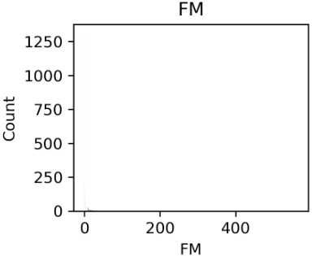
Data Distribution
Number of Features: 20
Ayres de Campos et al. (2000) SisPorto 2.0 A Program for Automated Analysis of Cardiotocograms. J Matern Fetal Med 5:311-318

Slide 11
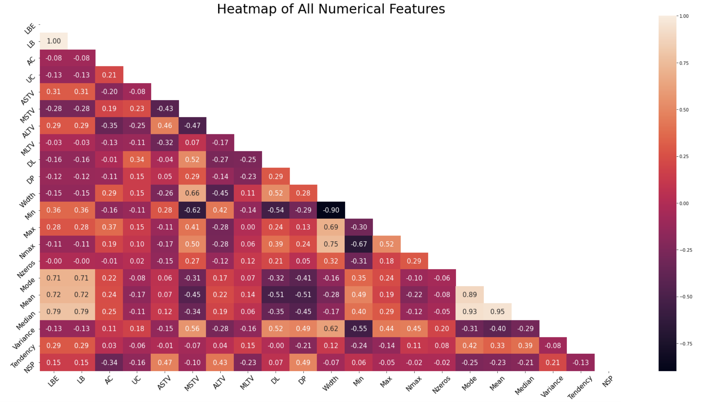
Correlation
Number of Features: 16
LB & LBE
Width & Min
Mode & Mean & Median

Slide 12
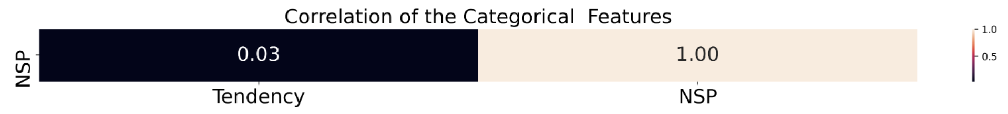
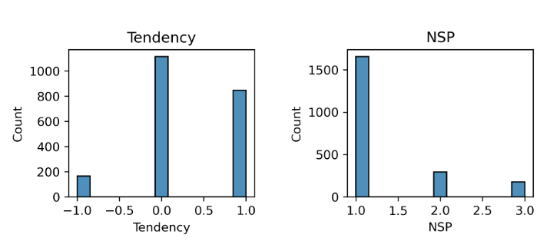
Chi Square Test
Number of Features: 15

Slide 13
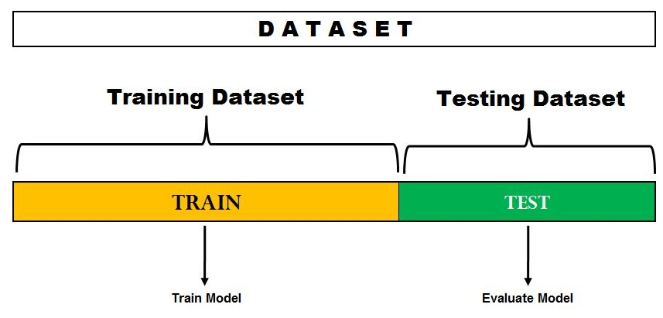
Dataset Splitting

Slide 14
Which algorithm gives better result？
Cross Validation of Models
Logistic Regression | 0.875234
Decision Tree | 0.907431
RandomForest | 0.928580
SVC | 0.830598

Slide 15
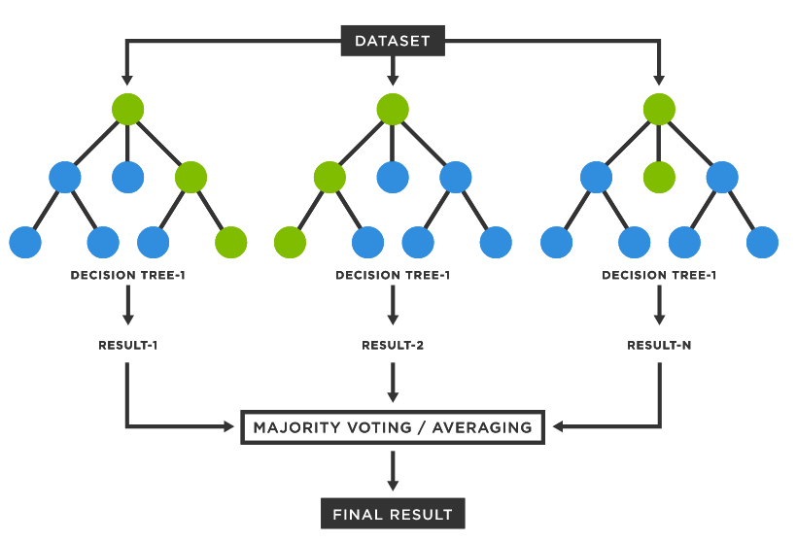
Random Forest

Slide 16
Advantages
Disadvantages
Handle lots of features without deletion
Generated forests can be saved for future
Able to derive variable importance measures
Overfitting when noise is high
Computationally intensive

Slide 17
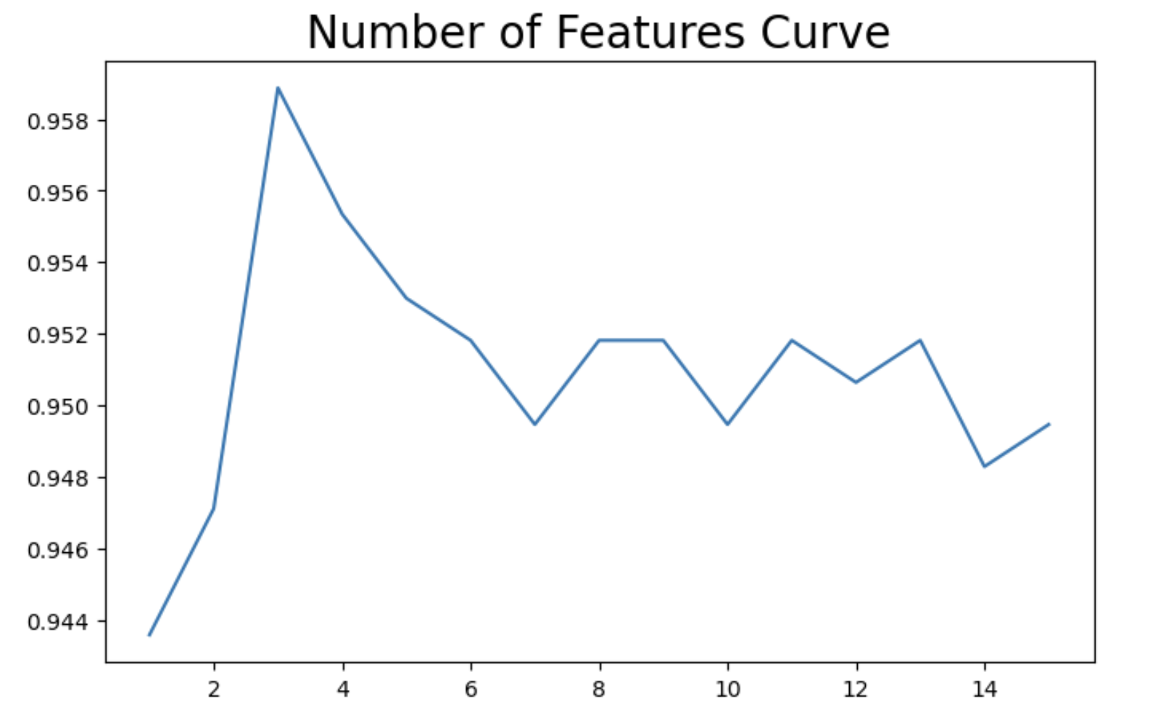
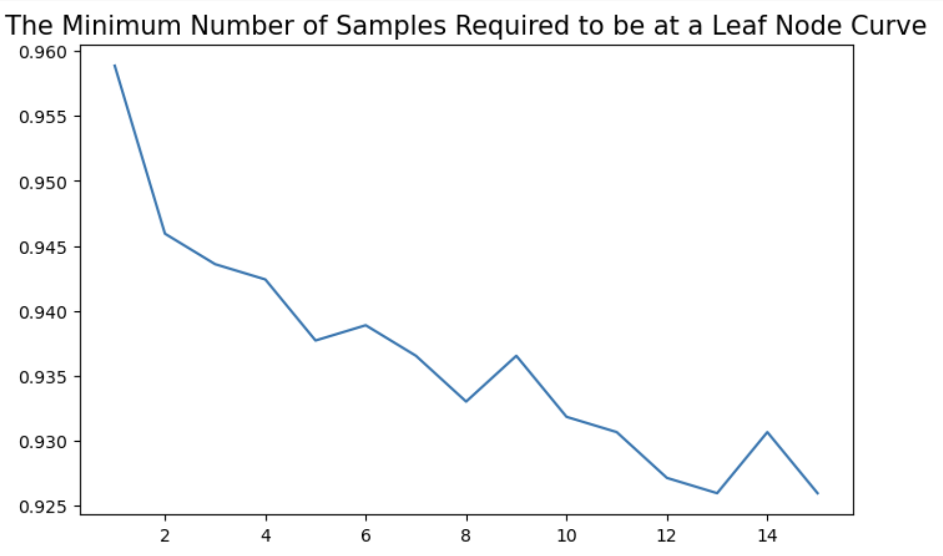
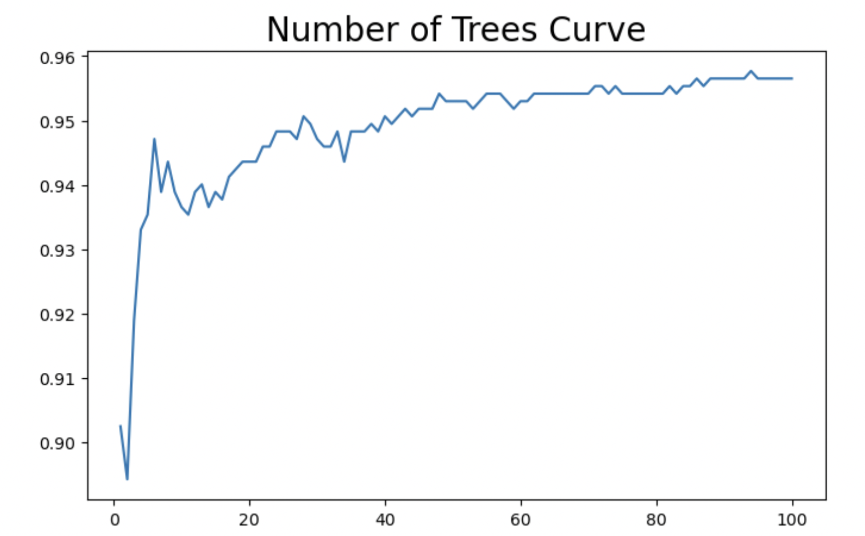
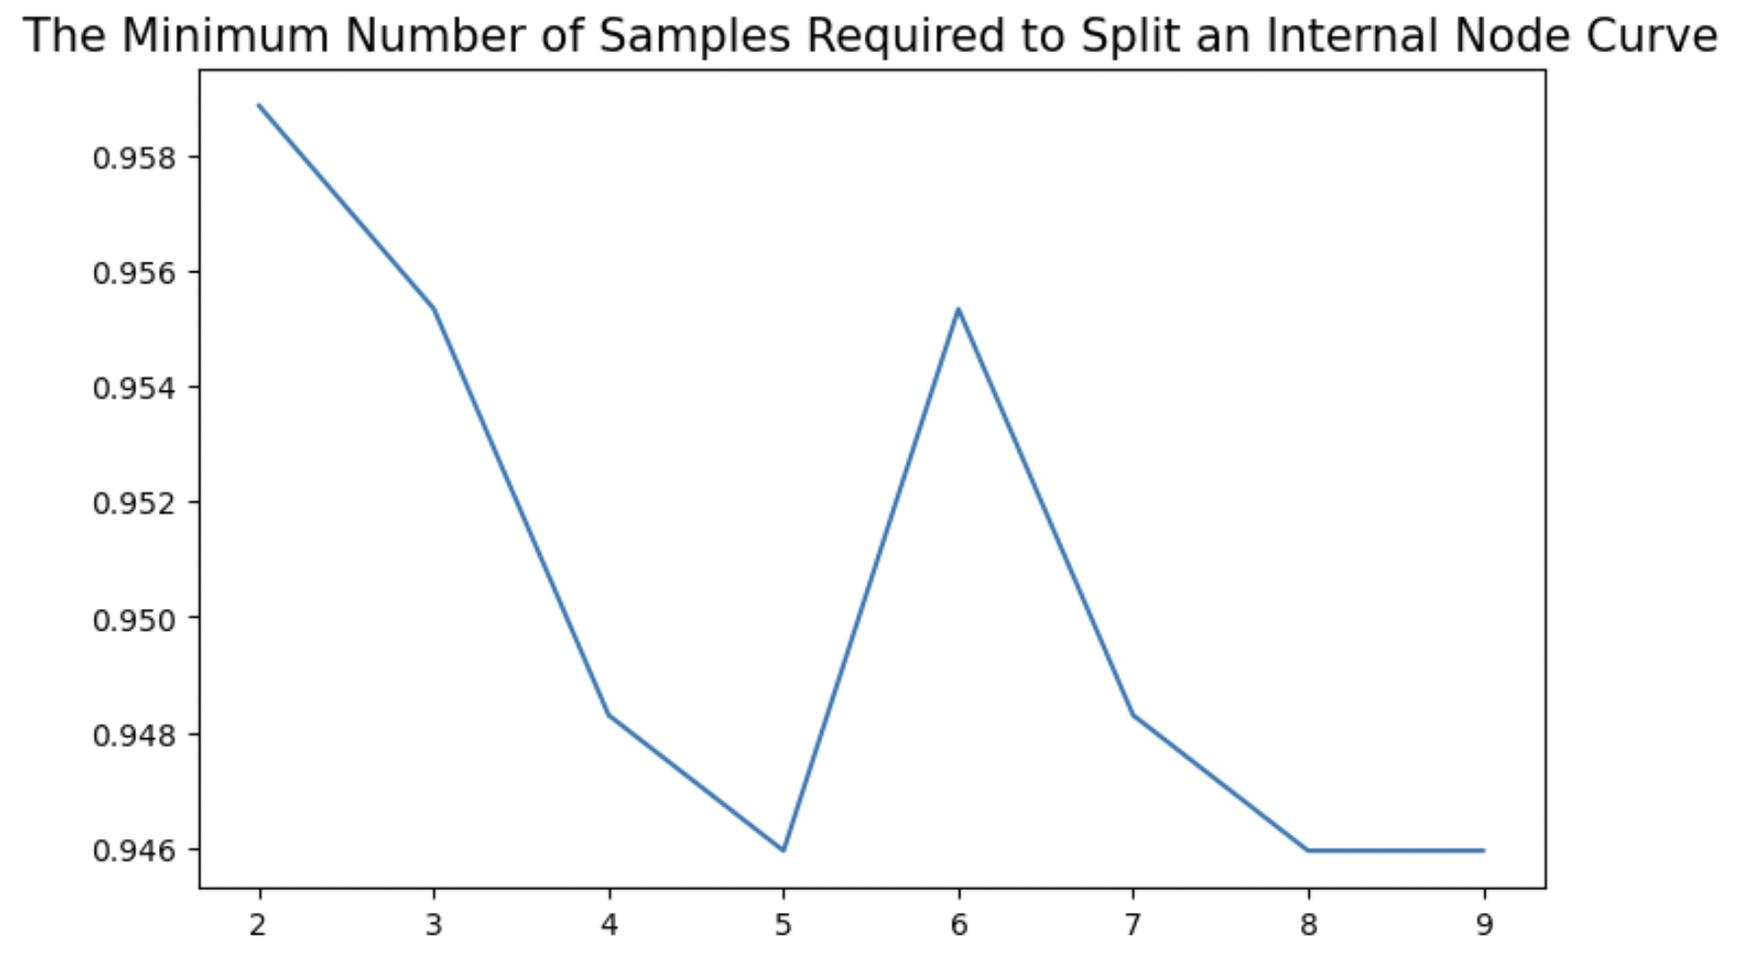
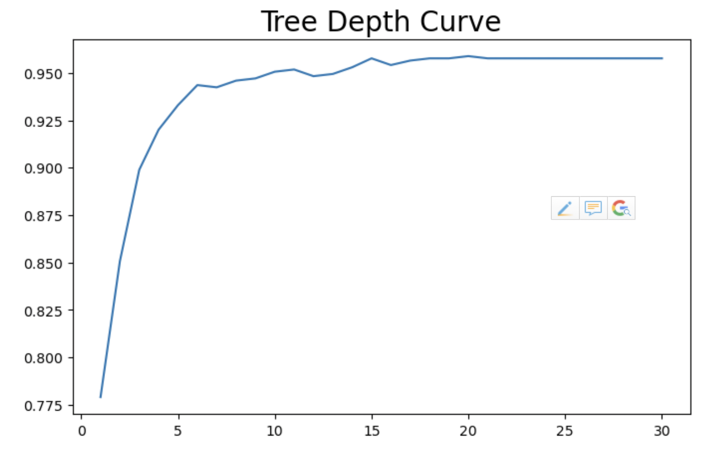
Hyperparameters
n_estimators | 94
max_depth | 20
min_samples_split | 2
min_samples_leaf | 1
max_features | 3

Slide 18
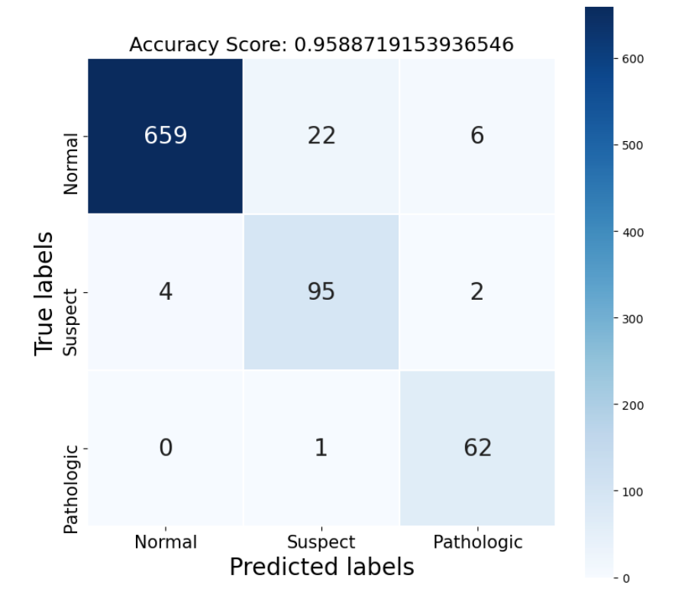
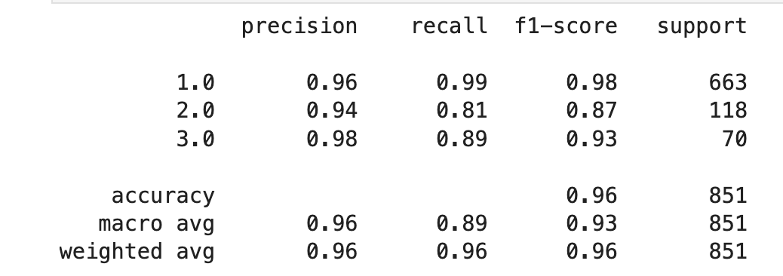
Model Evaluation
Train Score | 0.9984313725490196
Test Score | 0.9588719153936546
High Test Score
Does it ignore Pathologic?

Slide 19
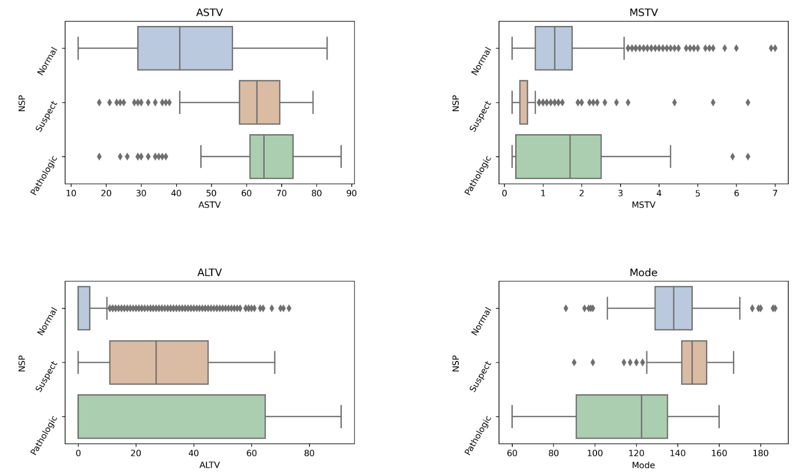
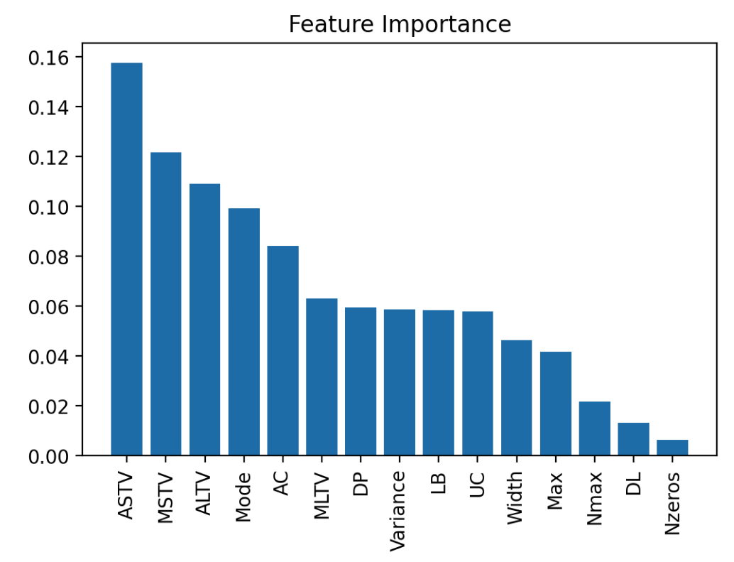
Which feature is most important?

Slide 20

Limitations
Lack of fetal development stage information
Not as a diagnostic result

Slide 21

My project in Github
Thank you for listening！

